Slide 1
Hello everyone, Welcome to MasterSoft student Login.
Let’s understand how you can successfully complete online registration process.

Slide 2
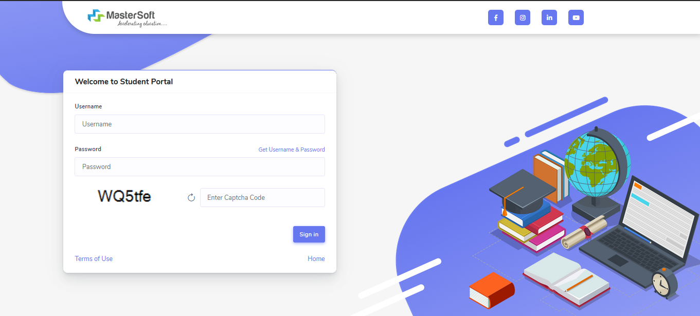
How to Login into the Portal …???
Click on https://cimsstudentnewui.mastersofterp.in/ to visit Student Portal Enter your Username and Password and Login into the System If you don’t have your login credential click on the "Get Username and Password" button given on the screen to retrieve the same.

Slide 3
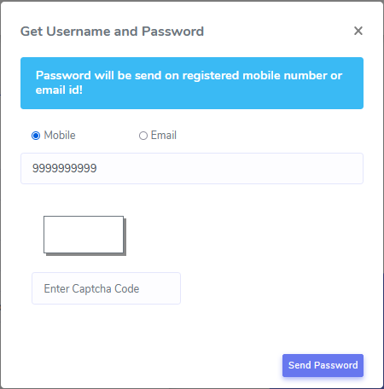
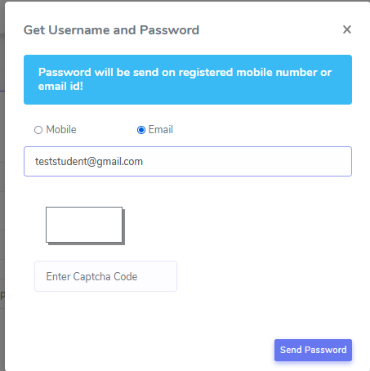
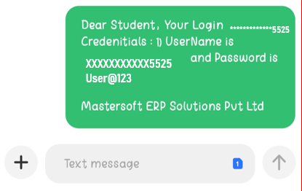
How to Get Username & Password..??
You need to enter your registered Mobile Number or Registered Email-id. Upon entering the mobile number or email id, username and password will be sent to your registered Mobile Number or Email-id Respectively.
MOBILE NUMBER
OR
EMAIL ID
Sample credentials SMS

Slide 4
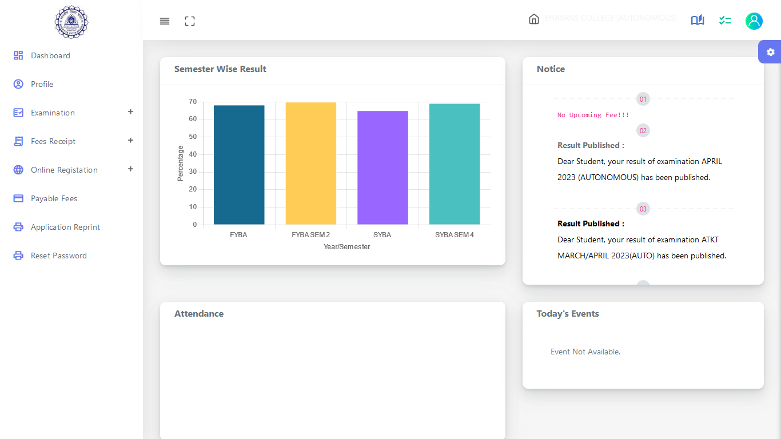
STUDENT DASHBOARD
As you can see this is your student dashboard where you can check semester-wise Results, Important Notices, Attendance Records, etc. You will be able to see Menu Bar with different pages which is present on the Left-Hand Side of the screen to navigate through different pages of the software

Slide 5
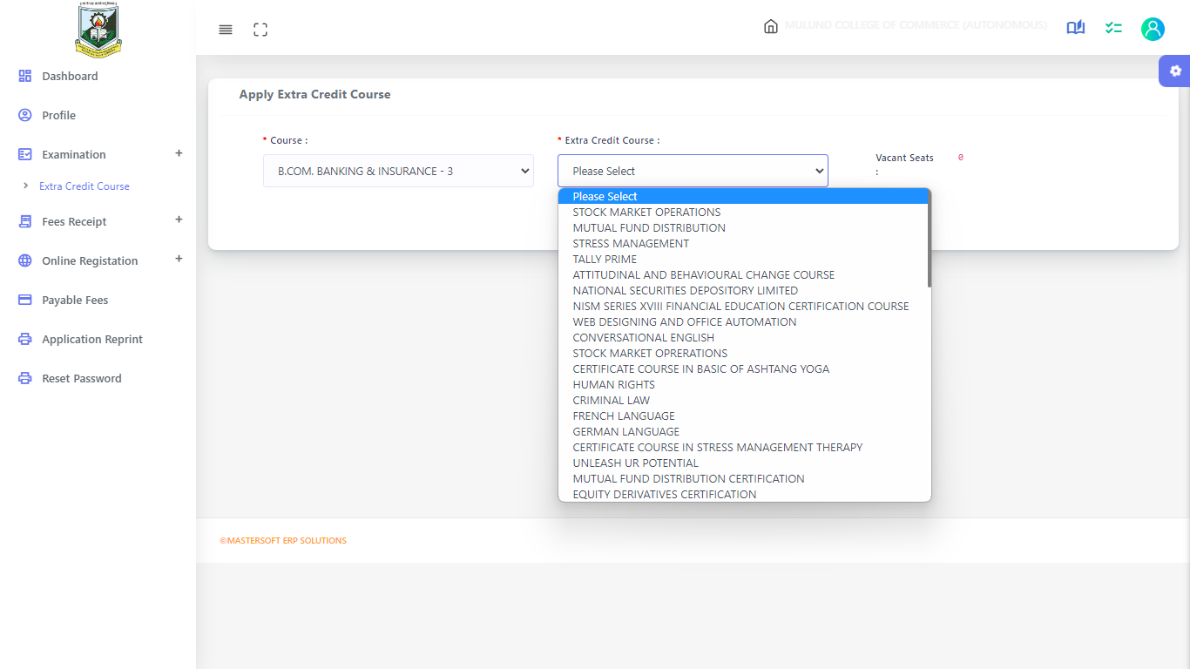
How to Apply for Extra Credit Course (If not applied)
Go to Examination-> Extra Credit Course

Slide 6
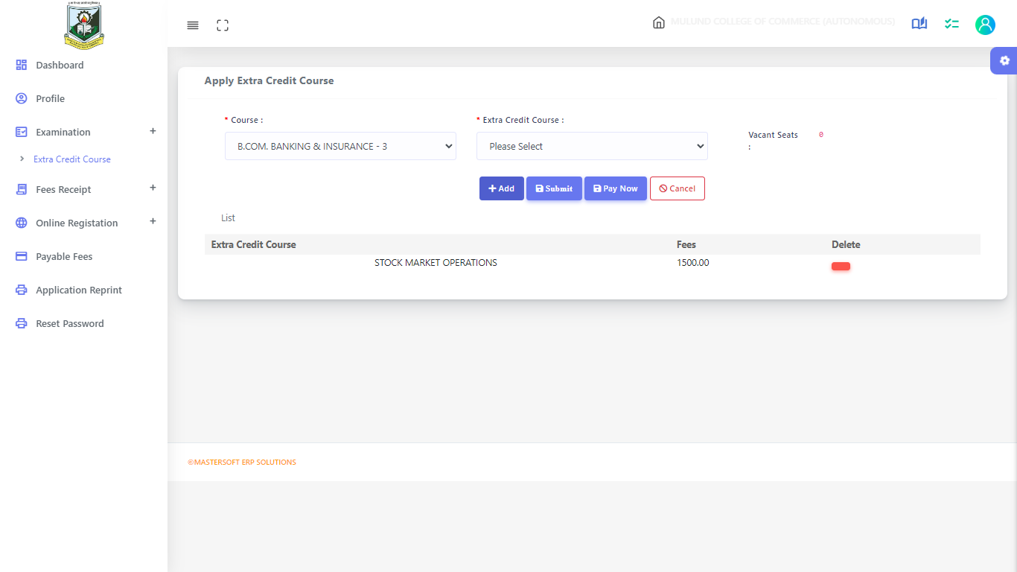
Procedure to Add and Apply Course
Select the Semester and Course which you want to apply for : > You can Add more than one course by clicking on Add Button > Click on Submit to Apply for Course You can pay fees now or at the time of Admission fee payment

Slide 7
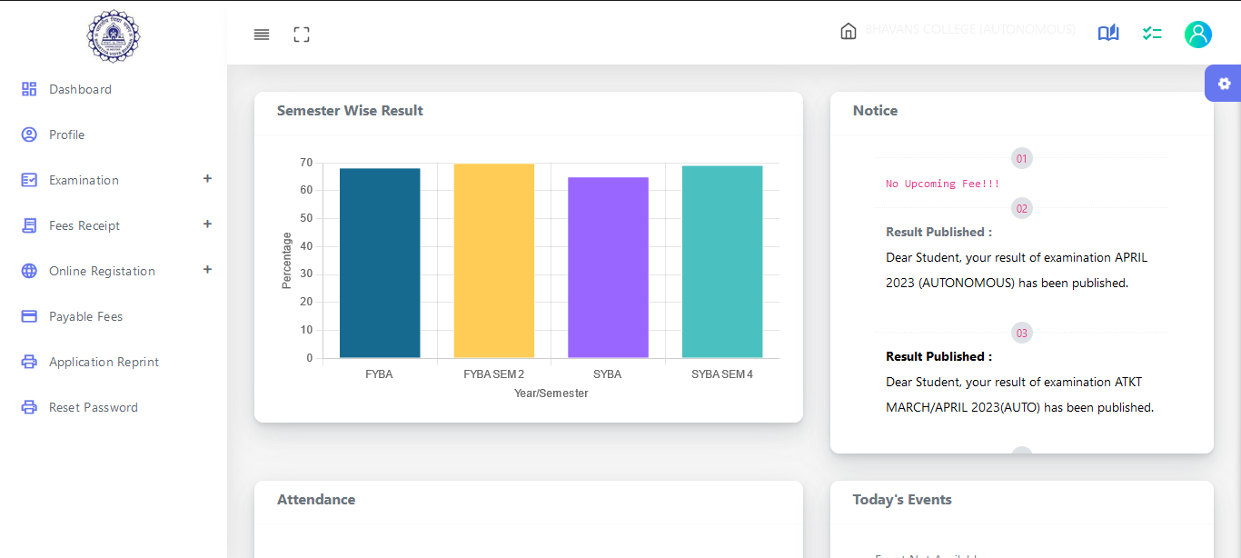
How to Start the Registration Process ?
To start the form filling process, click on the Online Registration Option present on the left-hand side of the screen.

Slide 8
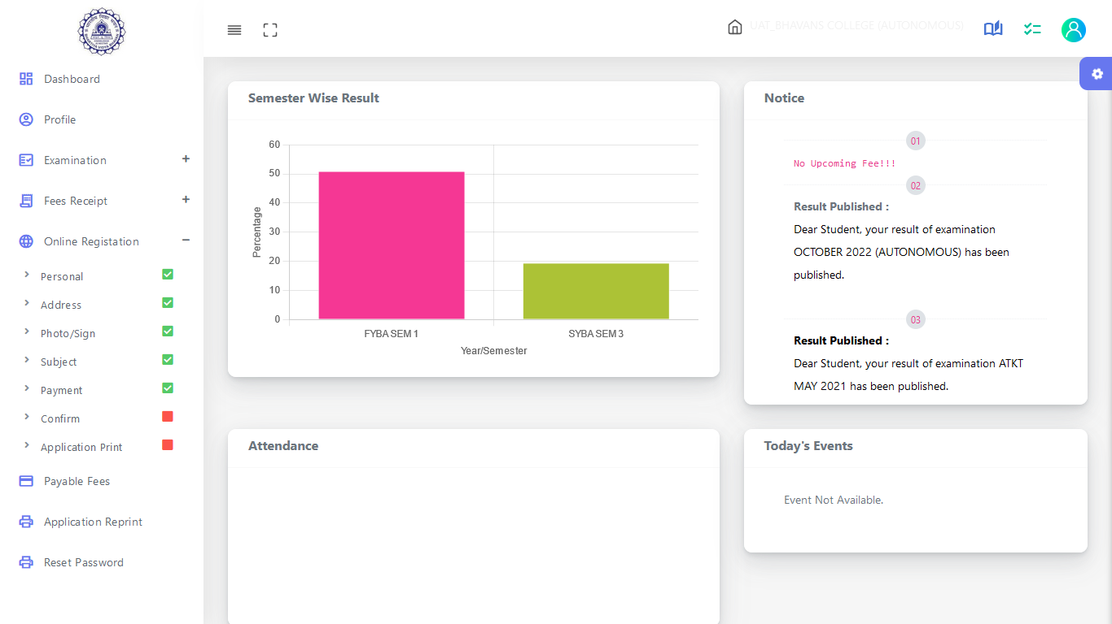
Step 1 :
As you click on the Online Registration Option present on the left-hand side of the screen., All the Sub menus will open up. Click on Personal Tab to Start Filling out the form

Slide 9
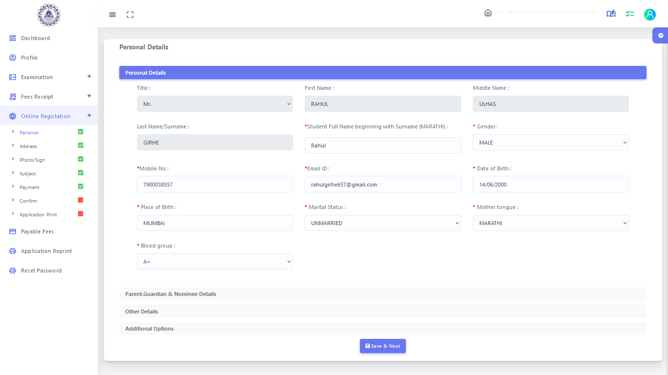
Step 2: Student’s Personal Section
Enter your personal details here like your first name, middle name, last name, email, gender, etc. Once you complete filling in the personal details Click on “Save and Next”
(Please note that all the fields marked with * are mandatory)

Slide 10
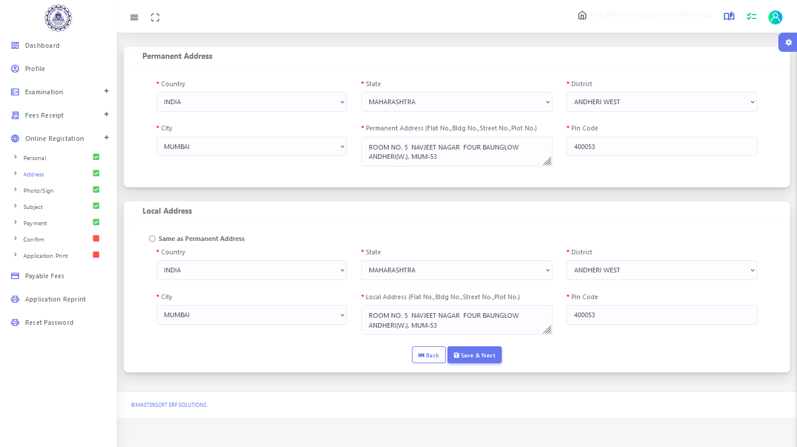
Step 3: Student’s Address Details
Next page is address details, here you need to fill in your Personal or Local address. Once you complete filling in the address details form Click on “Save and Next Button".
(Please note that all the fields marked with * are mandatory)

Slide 11
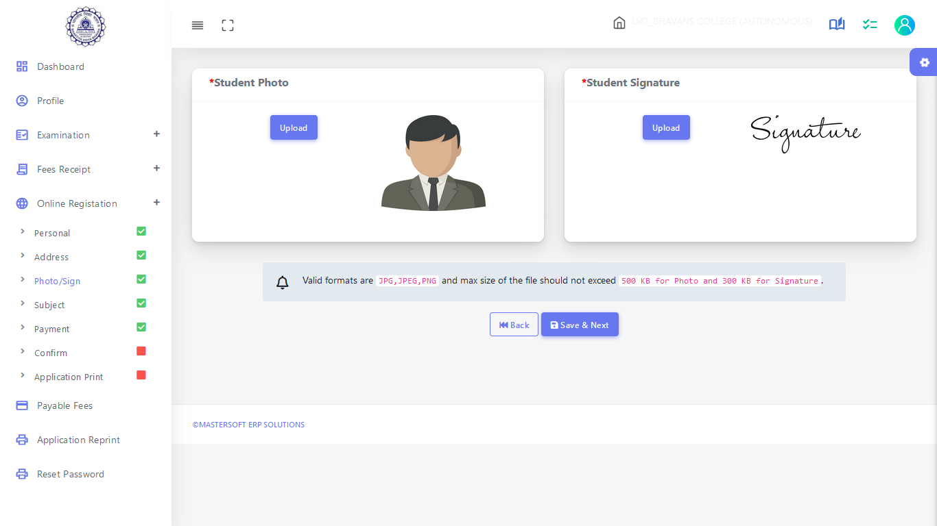
Step 4: Photo & Signature Details
Upload your Photo (recent Passport Size) and Signature and select the valid file. Once you complete uploading the photo and signature then Click on “Save and Next “
Please Note: Maximum Size of the Photo is 500kb and the Maximum Size of the Signature is 300kb)
(Please note that all the fields marked with * are mandatory)

Slide 12
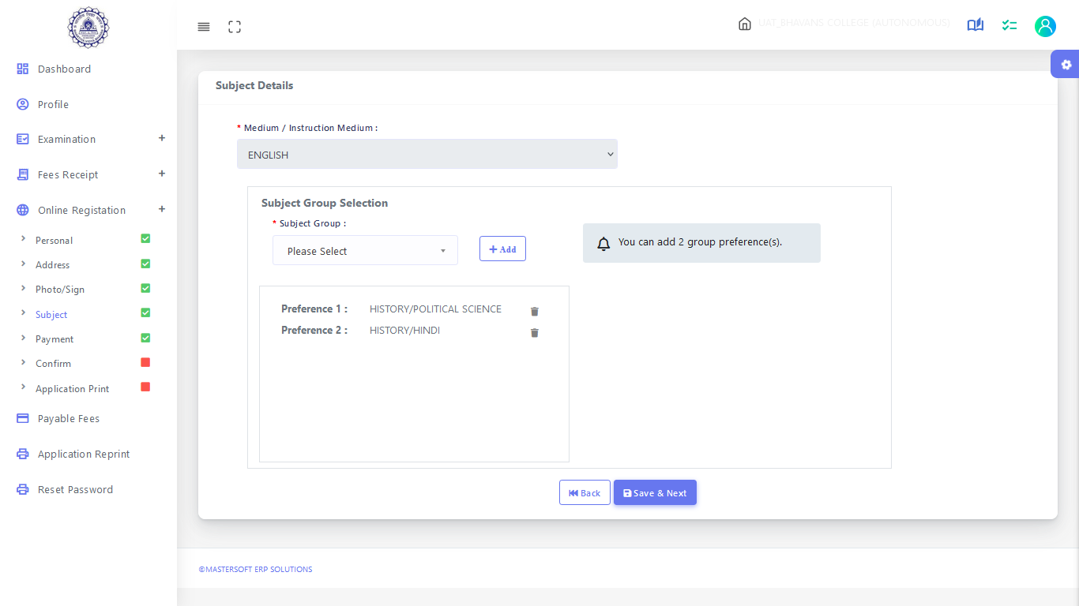
Step 5 : SUBJECT DETAILS (Not Applicable for Compulsory Subjects Courses)
Select Subject/subject group from the given options, then click on the "Add" button according to your preference. After adding, click on "Save and Next."
Kindly be informed that this page will only be visible to the course after it has been activated by the college

Slide 13
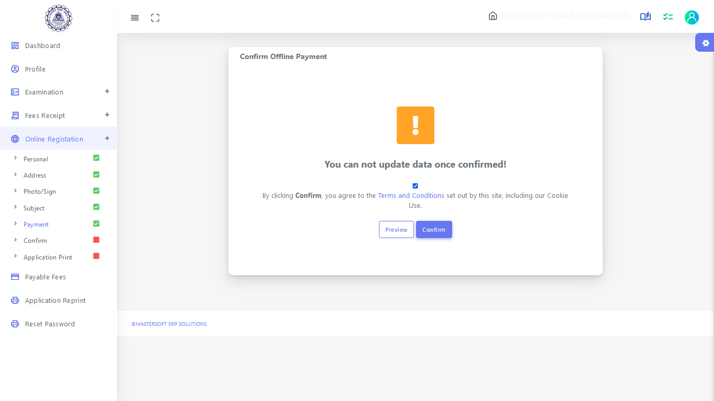
APPLICATION CONFIRMATION
Please verify the details you have entered by generating a preview report to ensure their accuracy. Please note that after confirmation, you won't be able to update or edit the data. Once you are certain that the entered details are true and correct, click on the "Confirm" button.

Slide 14
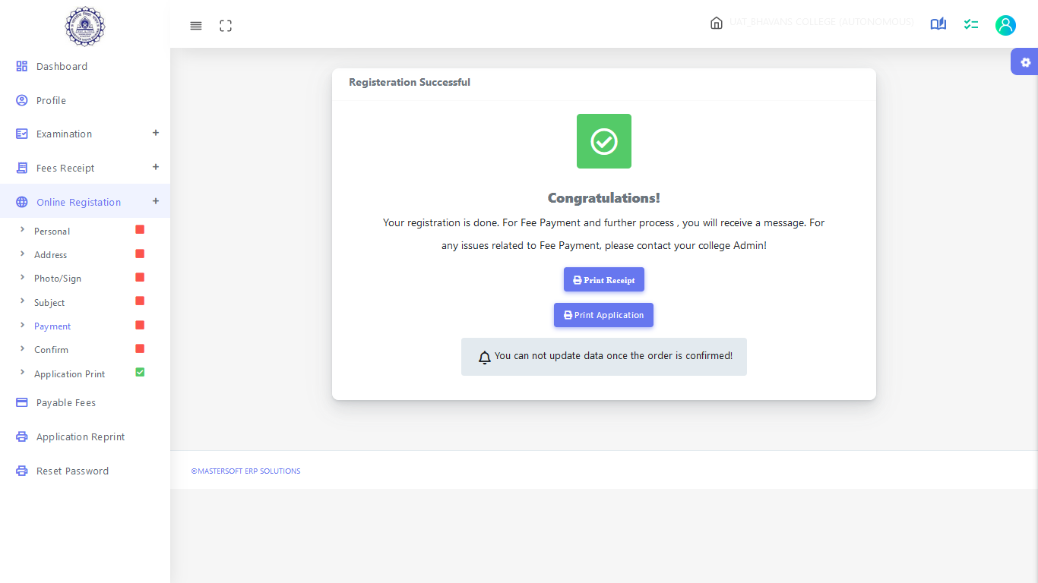
APPLICATION PRINT
To download the Application Report use the "Print Application" Option”. To download the Application Payment Receipt use the “ Print Receipt” Option

Slide 15
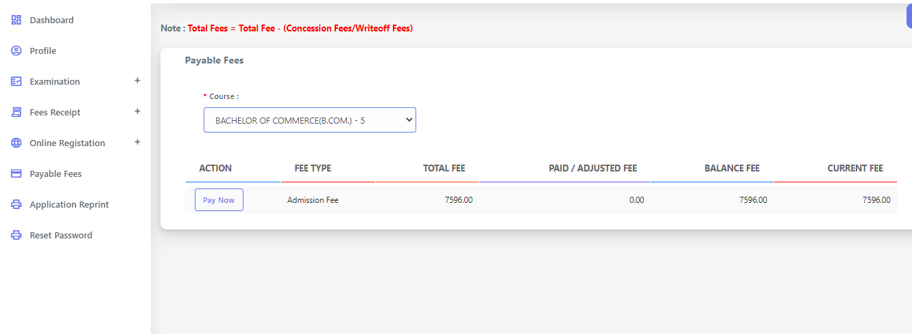
How to Pay the fees
Go to Payable Fees Tab and select your Semester -> Click on Pay Now

Slide 16
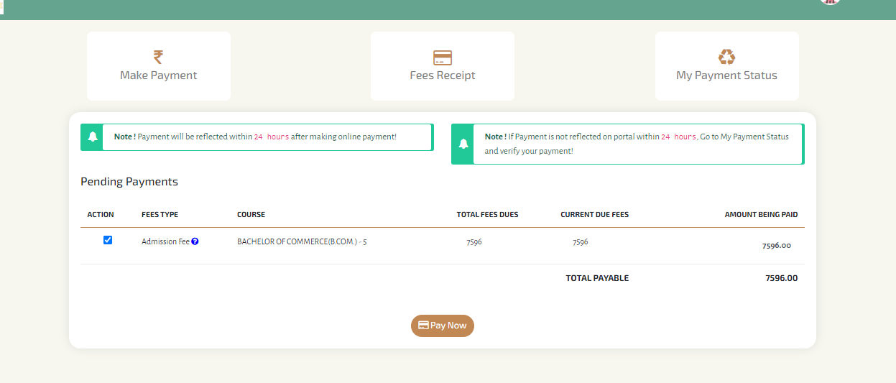
Payment of Fees
You will be redirected to Payment Gateway, Click on Pay Now and pay the fees After success ful payment, you can generate the Fees Receipt

Slide 17
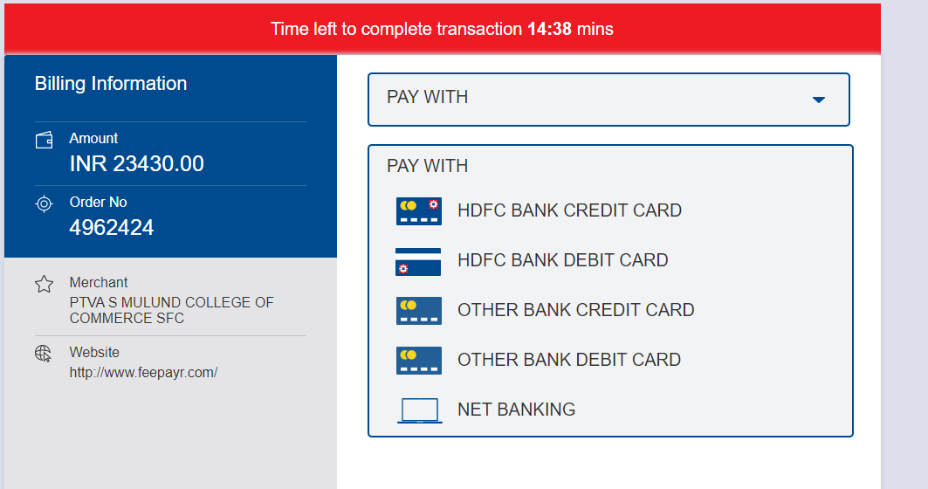
Modes of Payment

Slide 18
Thank You

